Slide 1
0x600 – Fault Attack Introduction
Dr. Colin O’Flynn
ECED4406

Slide 2
What are “Faults”?
“Faults” or “Glitches” are unintended operation, such as:
Wrong instructions executed.
Instructions not executed.
Data not written back.
Data corrupted in place.
Purposely generating these & using them to exploit a system will be called “glitch attacks” or “fault attacks”

Slide 3
Glitch Attacks – Code Flow Example
/*
* auth.c -- PAM authorization code, common between chsh and chfn
* (c) 2012 by Cody Maloney <cmaloney@theoreticalchaos.com>
*
* this program is free software. you can redistribute it and
* modify it under the terms of the gnu general public license.
* there is no warranty.
*
*/
#include "auth.h"
#include "pamfail.h"
int auth_pam(const char *service_name, uid_t uid, const char *username)
{
if (uid != 0) {
pam_handle_t *pamh = NULL;
struct pam_conv conv = { misc_conv, NULL };
int retcode;
retcode = pam_start(service_name, username, &conv, &pamh);
if (pam_fail_check(pamh, retcode))
return FALSE;
retcode = pam_authenticate(pamh, 0);
if (pam_fail_check(pamh, retcode))
return FALSE;
retcode = pam_acct_mgmt(pamh, 0);
if (retcode == PAM_NEW_AUTHTOK_REQD)
retcode =
pam_chauthtok(pamh, PAM_CHANGE_EXPIRED_AUTHTOK);
if (pam_fail_check(pamh, retcode))
return FALSE;
retcode = pam_setcred(pamh, 0);
if (pam_fail_check(pamh, retcode))
return FALSE;
pam_end(pamh, 0);
/* no need to establish a session; this isn't a
* session-oriented activity... */
}
return TRUE;
}
linux-util-2.24
int auth_pam(..., uid_t uid, ...){
if (uid != 0) {
...
bunch of checks using
different modules,
return FALSE if failed
...
}
return TRUE;
}

Slide 4
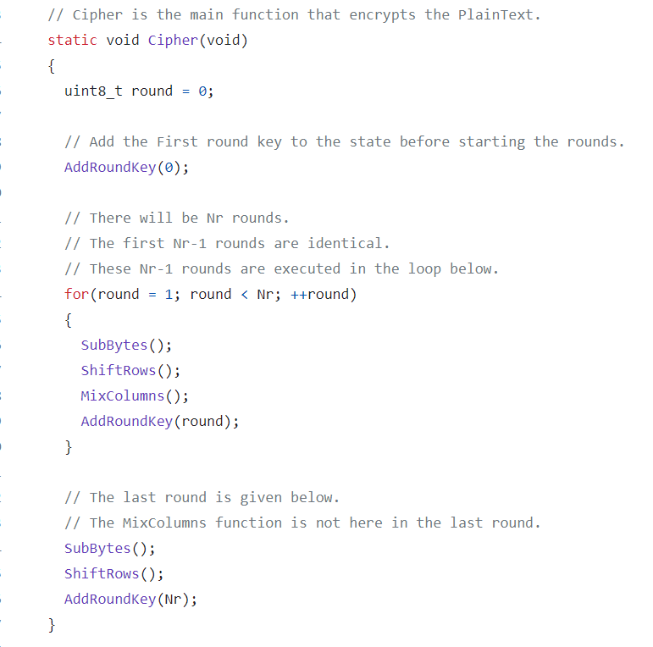
Glitch Attacks – Crypto 1
Glitch on ‘round’

Slide 5
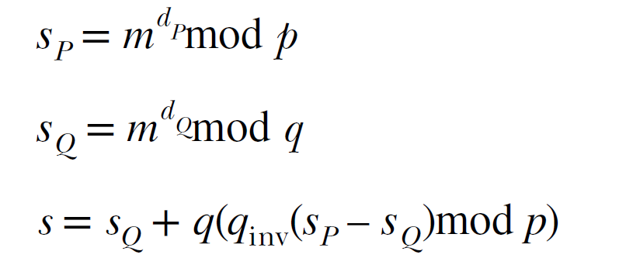
Glitch Attacks – Crypto 2
Chinese Remainder Theorem (CRT) version of RSA, RSA-CRT causes a substantial speed-up.
s = m^{d} mod (N) → Remember that N=pq, thus:
s = m^{d} mod (pq)

Slide 6
Glitch Attacks – Crypto 2 (cont’d)
(NOTE: I’m not going to be asking you to work that out on the exam – included only as a reference).
There is a problem with RSA-CRT: if one of the calculations is done incorrectly, the returned signature has a different factor than just p&q.
An attacker can use two signatures – one faulty (that has p & “something else”) and one not faulty (that only has p&q).
p is a common factor of both results, thus an attacker can determine p. Once you have p can find q.
Once you have p&q all is lost.

Slide 7
Differential Fault Analysis
These types of attacks are most commonly called Differential Fault Analysis (DFA).
DFA attacks use the difference between encryption with & without fault, or sometimes multiple encryptions where a fault is inserted.
They “look” similar to power analysis attacks, in that we observe many encryption operations & eventually recover the key.

Slide 8
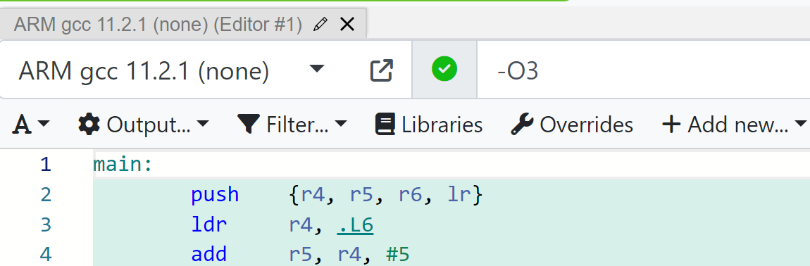
Glitch Attacks – Reading Past Buffer End
void putch(char c);
extern char tx_buffer[];
int main(void)
{
for(unsigned int i = 0; i < 5; i++){
putch(tx_buffer[i]);
}
return 0;
}
Drop this into https://godbolt.org , set compiler as ARM gcc (none), set options to -O3 and see what the assembly does…

Slide 9
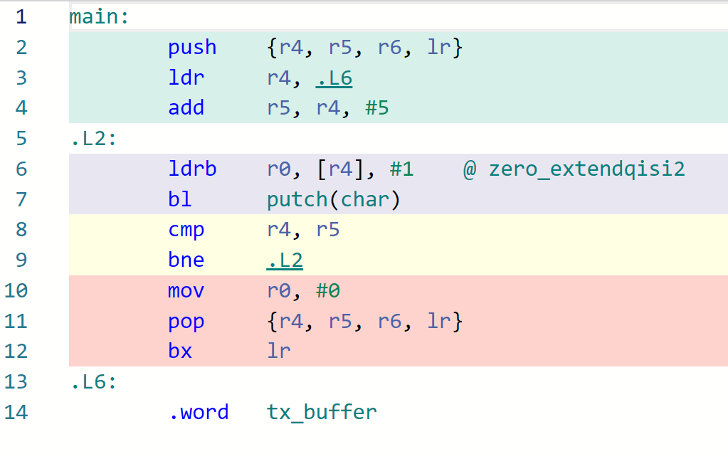

Glitch Attacks – Reading Past Buffer End
YIKES!! The assembly code has “branch if not equal”.
If you skip the compare/jump ONCE, and i becomes 6, the test fails! It will iterate much longer!

Slide 10
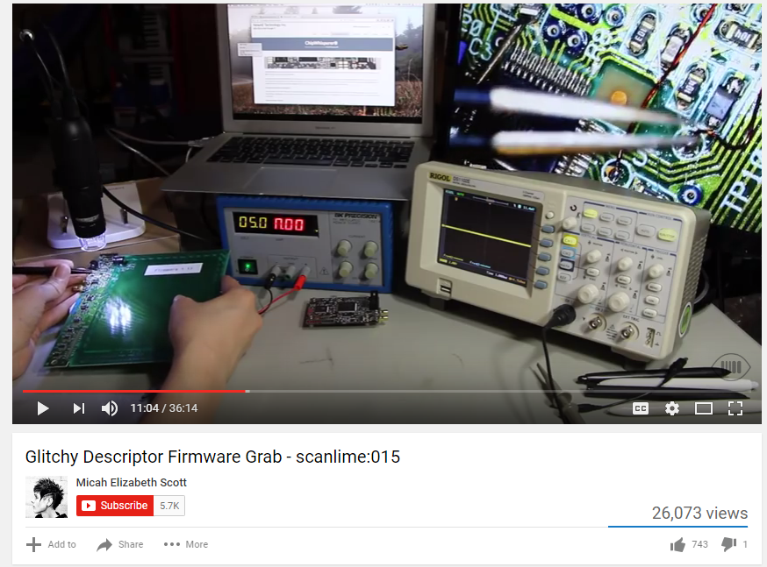
Example of Buffer Glitch Attack
https://www.youtube.com/watch?v=TeCQatNcF20

Slide 11
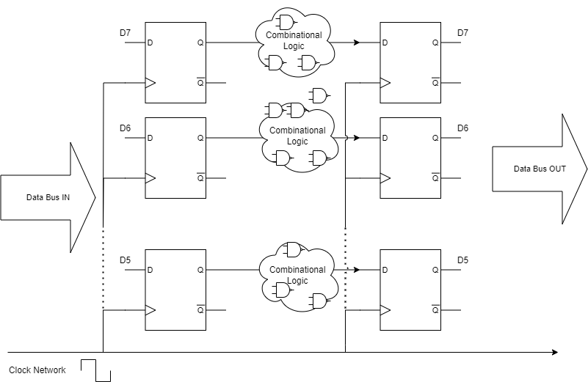
Fundamental Causes of Glitches

Slide 12
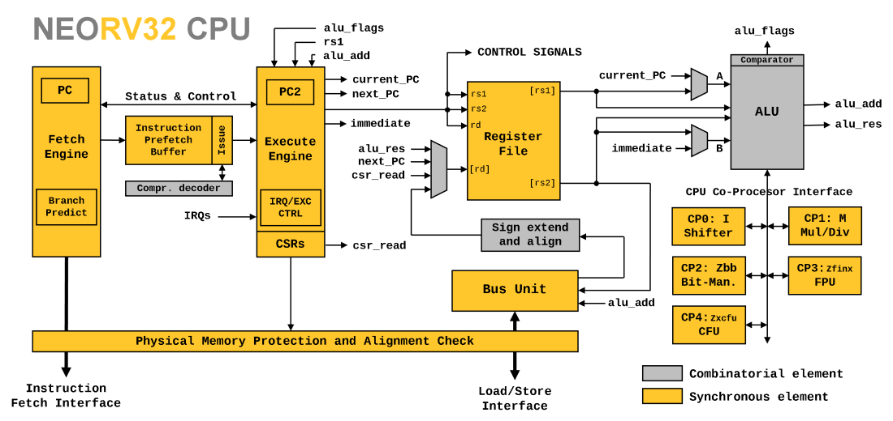
E.g., Processor Pipeline / FFs & Comb Logic

Slide 13
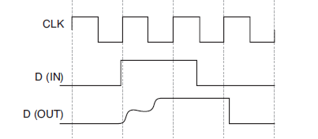
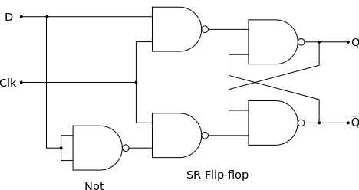
Metastability on Flip Flops

Slide 14
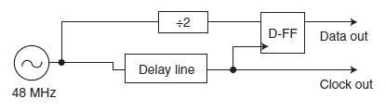
Metastability Experiments

Slide 15
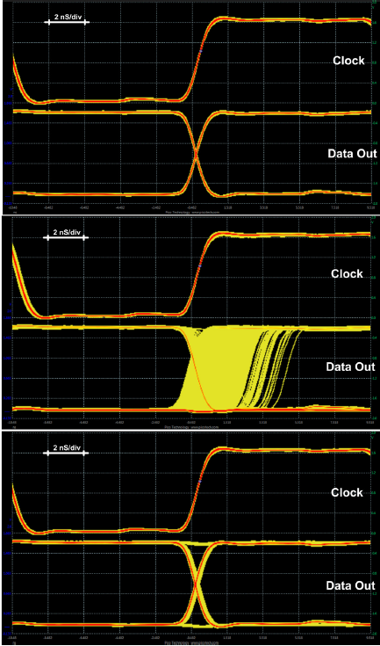
Normal
Timing Violated (Metastable)
with lower VCC
Timing Violated (Metastable) with Normal VCC

Slide 16
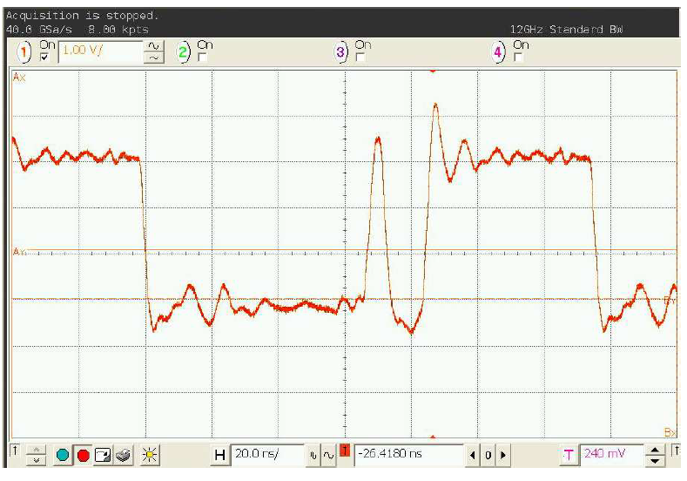
Inserting Glitches: Clock Glitching

Slide 17
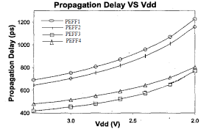
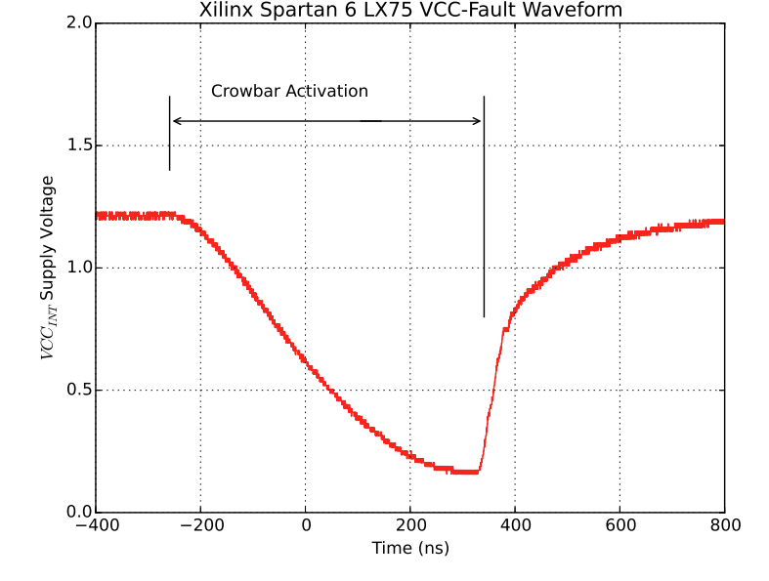
Inserting Glitches: Voltage Glitching

Slide 18
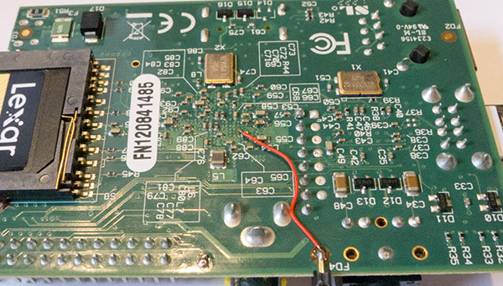
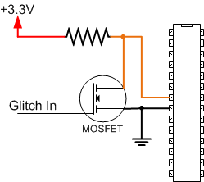
Example: Crowbar Voltage Glitching
https://www.youtube.com/watch?v=dVkCNiM0PL8

Slide 19
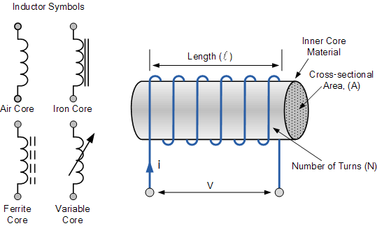
Inserting Glitches: EMFI Glitching

Slide 20
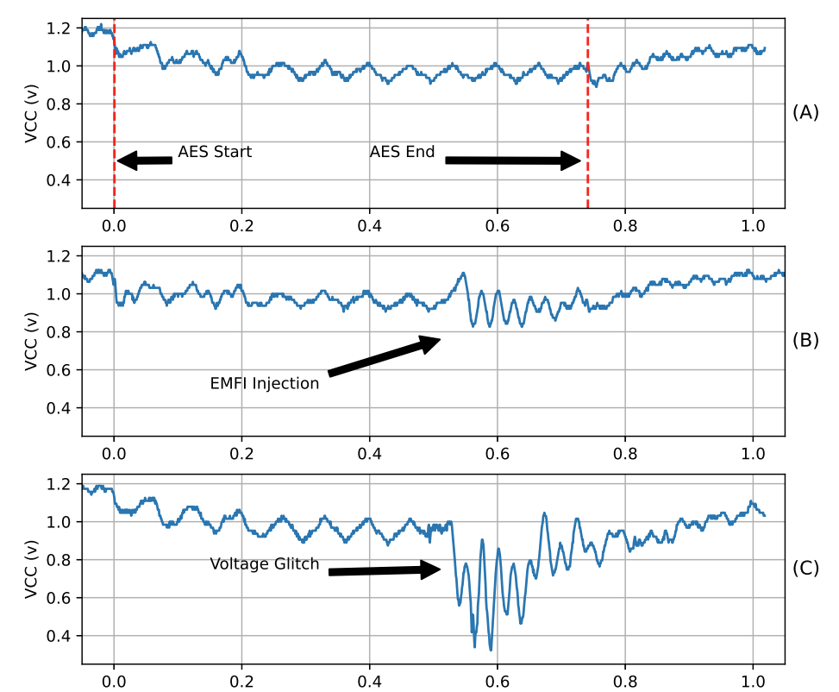
EM Results On-Chip

Slide 21
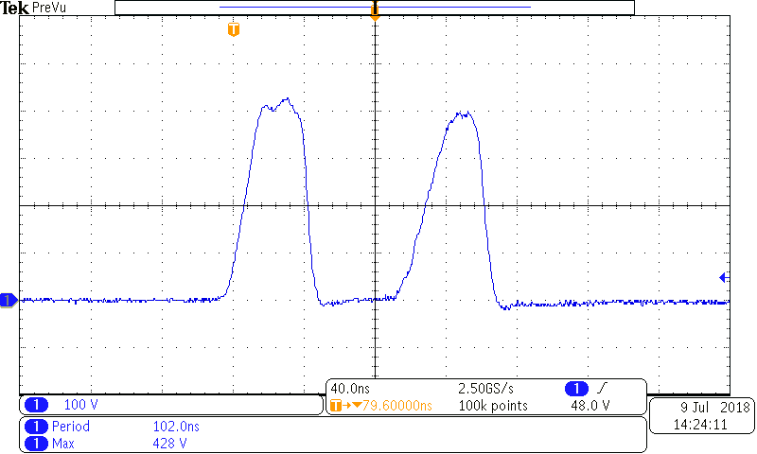
Pulse Shape Examples

Slide 22
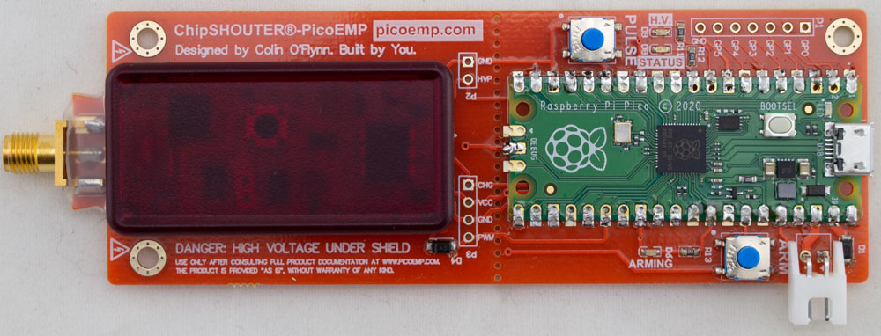
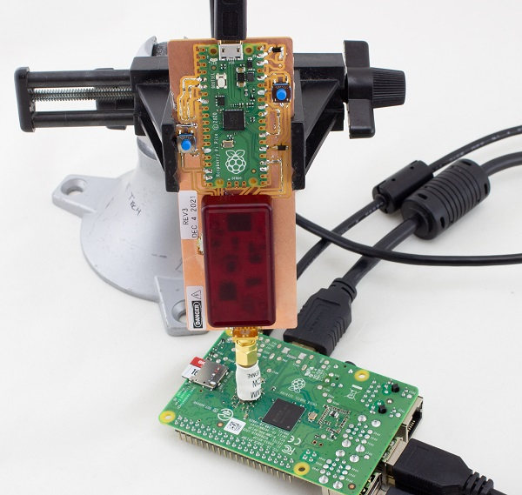
Low Cost EMFI Examples
PicoEMP project is an example of a low-cost EMFI tool. Need a way to generate a relatively short waveform, here shown attacking a R-Pi (again).

Slide 23
Countermeasure Types
Countermeasures are typically either doing one of:
Detecting the attack & taking action.
Preventing the attack.

Slide 24
Glitch Detection in Hardware
Several different methods of detecting glitches.
Remembering why glitches work, fundamental idea is to setup some “extra sensitive” flip flops (FFs).
FFs may just be setup to run in a ring, so easy to detect a sudden invalid sequence.

Slide 25
Glitch Detection in Software
Attackers often have some chance of hitting the code they want.
Possible to add simple “checks” that look for impossible conditions.
Be sure compiler doesn’t remove your impossible checks!
volatile uint32_t _checkvar = 0xDEADBEEF;
#define checkval() if (_checkvar != 0xDEADBEEF) {goto fail;}

Slide 26
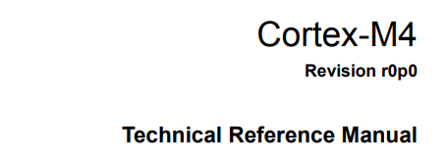
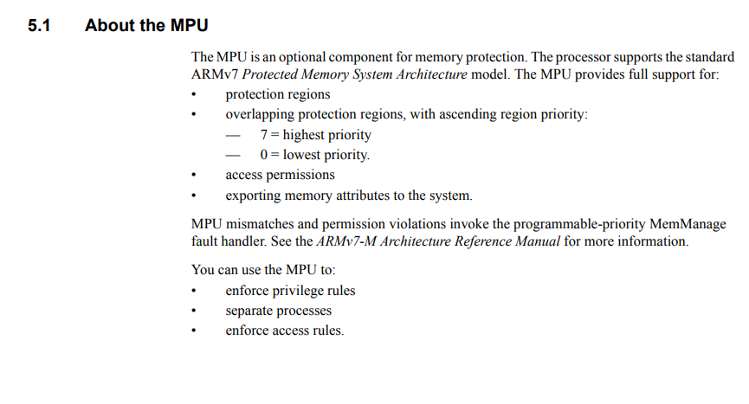
General: Memory Integrity
Many glitch attacks mean an attacker is reading memory they shouldn’t have access to.
Enabling the “Memory Protection Unit” is possible on even most small microcontrollers.
E.g., Cortex-M4 →

Slide 27
General: Control Flow Integrity (CFI)
Control Flow Integrity (CFI) is methods of ensuring code is not taking “unauthorized” paths.
Can be enforced at hardware or software.
For example – keeping a hash of allowed program flows, or allowed return addresses.
CFI normally concentrates on projection against attacks beyond glitches, but may also provide some glitch protection

Slide 28
Ex Countermeasure: Multiple Checks
Critical code paths can be checked multiple times.
Best to maintain some state variable, this state can be checked by running code to ensure someone has not just e.g., called an unlock() function directly without the system being in the “unlocked” state.

Slide 29
Calculating State Variable
Setting the state variable will be a sensitive point
Better if the state variable is set via a calculation
Example of bad password check:
unlocked = 0;
if (strcmp(password, “hunter2”))
unlocked = 0xff;
Example of better password check:
unlocked = (password[0] ^ 'h' ^ 0xff) & (password[1] ^ 'u' ^ 0xff) & ... & (password[6] ^ '2' ^ 0xff)

Slide 30
Complex State Variables
In previous examples – state variables were still fairly simple (0 or 0xff). Using complex values & covering all states is even better:
#define SIG_OK 0xDEADBEEF
#define SIG_BAD 0xCAFEFACE
unsigned int sig_ok = 0;
sig_ok = thetest();
if (sig_ok == SIG_OK) {
//do the thing
} else if (sig_ok == SIG_BAD) {
//bad
} else {
//very bad
}
unsigned int sig_ok = 0;
sig_ok = thetest();
if (sig_ok){
//do the thing
}
else {
//bad
}
VS

Slide 31
Ex Countermeasure: Pointer Mangling
#define SIG_OK 0xDEADBEEF
#define SIG_BAD 0xCAFEFACE
uint8_t * dataptr = RAM_BOOT_LOCATION ^ SIG_OK;
unsigned int result = 0;
result = sig_dotest(dataptr ^ SIG_OK);
dataptr = dataptr ^ result;
if (result == SIG_OK) {
(*dataptr)();
}

Slide 32
Fault Injection (Glitch) Attacks
These are a very powerful class of attacks, as they break many of the fundamental assumptions.
Can be used for leaking cryptographic keys through Differential Fault Analysis (DFA), OR can simply bypass authentication routines.
Glitches come from the introduction of timing errors.
Glitches can be inserted in many ways, here we covered clock, voltage, and electromagnetic fault (EMFI).
Various methods of detecting & countermeasures covered.
Most important – turn on Memory Protection Unit!!

